Slide 1
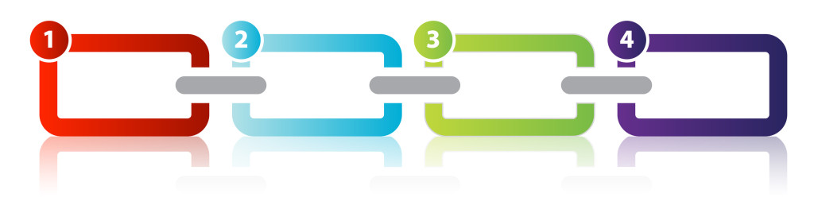
Design Pattern
Chain of Responsibility

Slide 2
Introduction
Design patterns are typical solutions to common problems in software design.
Chain of Responsibility is one of the Behavioral Design Pattern introduced by Gang of Four.
Chain of responsibility pattern is used to achieve loose coupling in software design, where a request from client is passed to a chain of objects to process it.

Slide 3
Intent
Avoid coupling the sender of a request to its receiver by giving more than one object a chance to handle the request.
Chain the receiving objects and pass the request along the chain until an object handles it.
Launch-and-leave requests with a single processing pipeline that contains many possible handlers.
An object-oriented linked list with recursive traversal.

Slide 4
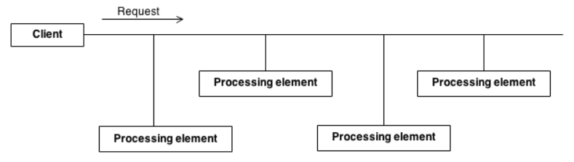
Need
There can be potentially variable number of "handler" or "processing element" or "node" objects, and a stream of requests that must be handled.
Need to efficiently process the requests without hard-coding handler relationships, handler precedence, or request-to-handler mappings.

Slide 5
Working
Processing elements are encapsulated inside a "pipeline" abstraction.
Clients "launch and leave" their requests at the entrance to the pipeline.
Chains the receiving objects together, and then passes request messages from object to object until it reaches an object capable of handling the request.
The number and type of handler objects isn't known a priori, they can be configured dynamically.
Uses recursive composition to allow an unlimited number of handlers to be linked.
Chain of Responsibility simplifies object interconnections.
"Safety Net" is created to "catch" any requests which go unhandled.

Slide 6
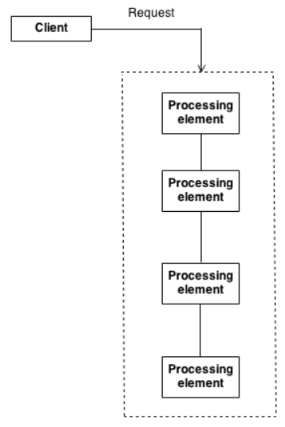

Slide 7
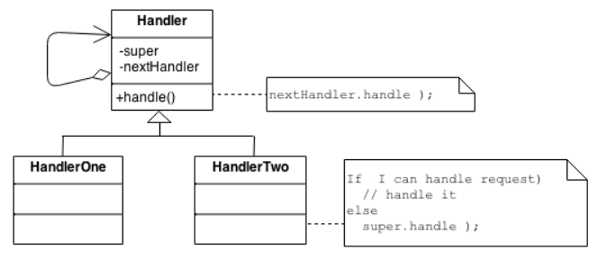
Architecture
The derived classes know how to satisfy Client requests. If the "current" object is not available or not sufficient, then it delegates to the base class, which delegates to the "next" object, and the circle of life continues.
Multiple handlers could contribute to the handling of each request. The request can be passed down the entire length of the chain, with the last link being careful not to delegate to a "null".

Slide 8
Participants
Handler :
This can be an interface which will primarily recieve the request and dispatches the request to chain of handlers. It has reference of only first handler in the chain and does not know anything about rest of the handlers.
Concrete handlers :
These are actual handlers of the request chained in some sequential order.
Client :
Originator of request and this will access the handler to handle it.

Slide 9
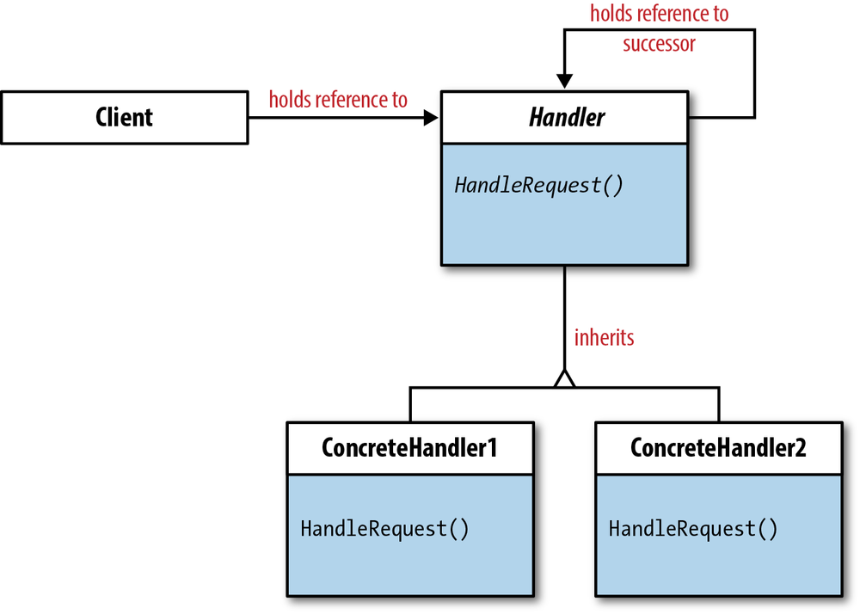
UML Diagram

Slide 10
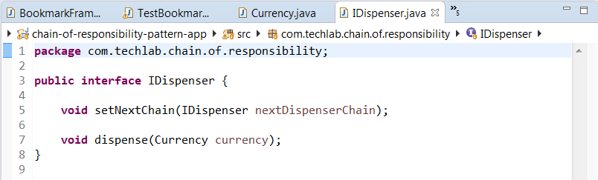
Code Snippet

Slide 11
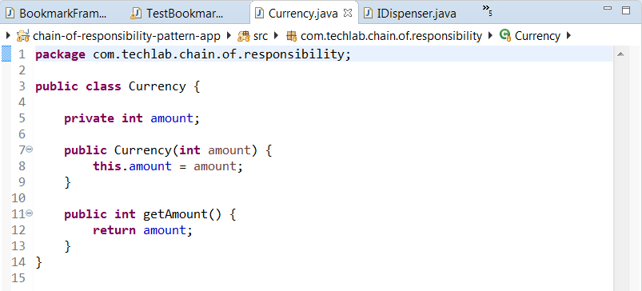
Code Snippet

Slide 12
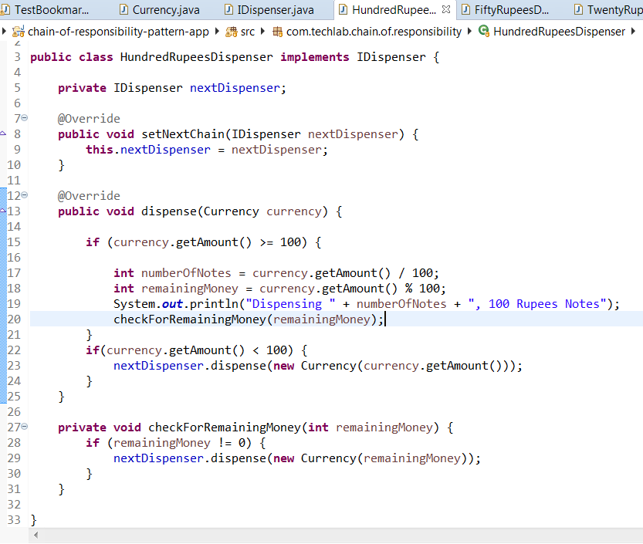
Code Snippet

Slide 13
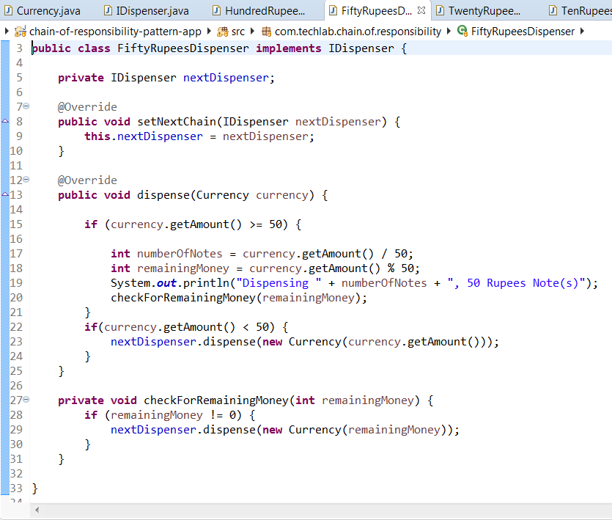
Code Snippet

Slide 14
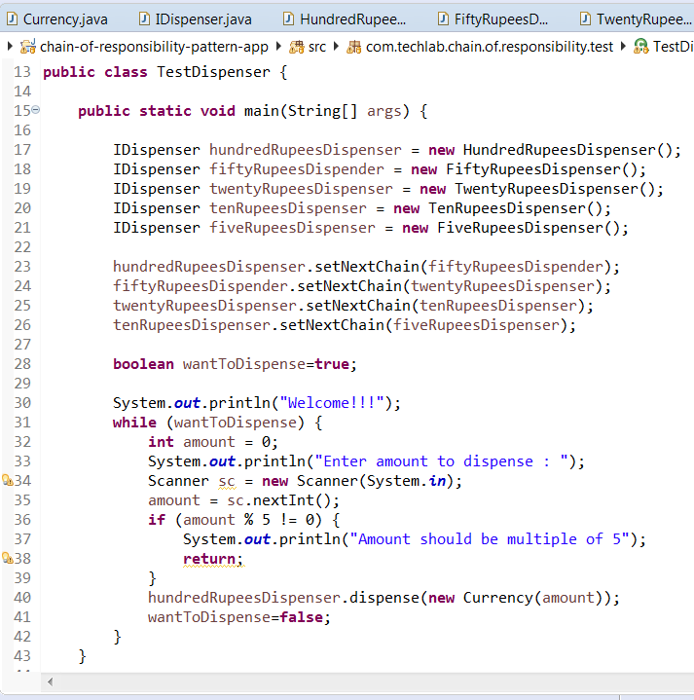
Code Snippet

Slide 15
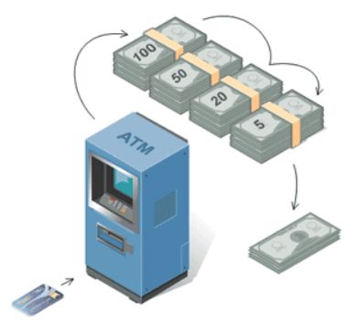
Real Life Example
ATM uses the Chain of Responsibility Pattern in money dispensing mechanism.
User enters the amount to be retrieved and the ATM dispense amount in terms of defined currency bills such as 100 Rs, 50 Rs, 20 Rs, 5 Rs, etc.

Slide 16
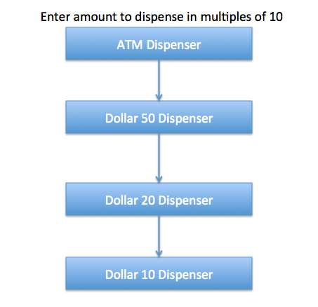

Slide 17
Uses
To avoid coupling a request’s sender and receiver
Multiple objects to be determined at runtime, are candidates to handle a request
Don’t want to specify handlers explicitly in your code
When you want to issue a request to one of several objects without specifying the receiver explicitly.

Slide 18
Points to Remember
The base class maintains a "next" pointer.
Each derived class implements its contribution for handling the request.
If the request needs to be "passed on", then the derived class "calls back" to the base class, which delegates to the "next" pointer.
The client (or some third party) creates and links the chain (which may include a link from the last node to the root node).
The client "launches and leaves" each request with the root of the chain.
Do not use Chain of Responsibility when each request is only handled by one handler, or, when the client object knows which service object should handle the request.

